Slide 1
Agency-Enabled Retail Donations Webinar:
*NEW* Mandatory Food Safety Temperature-Control Monitoring
Wednesday, September 13, 2017
10:00 – 10:30 AM

Slide 2
Agenda
Welcome & Introductions
Overview of Temperature Control Monitoring
Receiving Requirements for Refrigerated & Frozen Items
Logging & Archiving Requirements
Temperature & Thermometer Guidelines
Available Temperature Control Resources
Q&A/Wrap Up
Fighting Hunger, Improving Lives, Strengthening Communities

Slide 3
Overview of Temperature Control Monitoring
In order to provide the highest quality products to our clients, we must assure measures are taken to maintain the cold chain, from receipt through distribution.
Per the requirement of Feeding America, and as an added level of food safety for your clients, all time/temperature sensitive foods (refrigerated and/or frozen) collected through the Agency Enabled Donation Program MUST have temperatures taken from samples at time of pickup and again at time of delivery/upon return to agency.
All agency partners participating in the donation program will be required to sign an Agency-Enabled Contract (NEW), in compliance with Feeding America, the Central PA Food Bank, and the Agency-Enabled Donation program. This document will become a part of each partner agency’s file.
Fighting Hunger, Improving Lives, Strengthening Communities

Slide 4
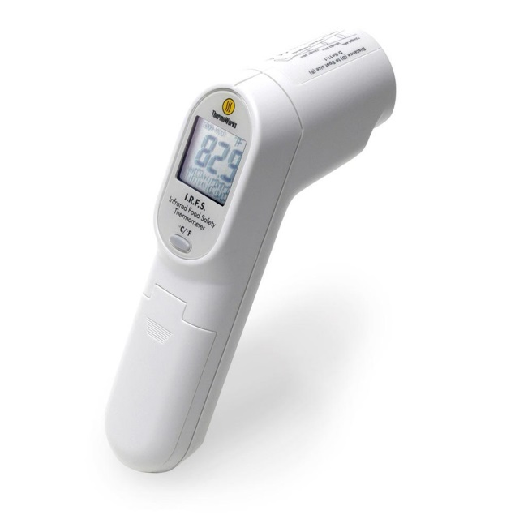
Overview of Temperature Control Monitoring (continued)
To assist in this process the Central Pennsylvania Food Bank will provide an Infrared Food Safety Thermometer (temperature gun) to partner agencies participating in the Agency Enabled Donation Program who regularly pick up time/temperature sensitive foods.
As with other food safety and program implementation tools that the Food Bank provides, it will be the responsibility of the agency to maintain and safe-keep this item. One temp gun will be issued per qualifying agency partner.

Slide 5
Receiving Requirements
Upon arrival at the donor you must record temperatures from a sample of the products you are picking up with a laser thermometer (temperature gun).
A sample is defined as about 2-3% of the total of the product you are picking up. For example; if you are picking up 100 cases of product you should record temperatures from 2-3 of the 100 cases.
These temperatures should be recorded on a log (provided) and kept on file.
After recording temperatures from the required amount of product you will need to place product in either PASSIVE or ACTIVE temperature maintenance.

Slide 6
Receiving Requirements - continued
PASSIVE temperature maintenance can be used when traveling for less than 30 minutes. This can be achieved by using a freezer blanket or insulated cooler. With the use of passive temperature maintenance, the use of ice packs is highly recommended.
When traveling for periods more than 30 minutes, ACTIVE maintenance must be used. Active maintenance is the use of refrigeration while in transit.
Upon arrival at your facility you must again record temperatures from a sample of the products you have picked up. These temperatures should be recorded on the same log used to record donation pick-up temperatures.

Slide 7
Logging & Archiving Requirements
Temperatures MUST be recorded on a temperature log: ONCE at the time of donor pick up and AGAIN upon delivery to agency storage.
Temperature logs are required to be kept on file for three (3) years.
Temperature logs will become part of normal compliance inspections (site visits) effective 11/1/2017.
Temperature logs must be produced for inspection upon agency site visit.
Donations that are not sensitive to time/temperature control (Bakery, Dry Goods, Produce) do not require temperature monitoring and/or temperature logs.
Fighting Hunger, Improving Lives, Strengthening Communities

Slide 8
Temperature & Thermometer Guidelines
REFRIGERATED PRODUCTS:
Uncut produce <60 degrees F
Cut or Sliced Produce <41 degrees F
Eggs <41 degrees F
Milk <41 degrees F
Yogurt <41 degrees F
Meats <41 degrees F
Misc. Deli/Prepared/Dairy Items <41 degrees F
FROZEN PRODUCTS:
All frozen products should be received at or below 0 degrees F. All product should be frozen solid. Fish and shellfish product should be provided in separate packaging.
**PLEASE NOTE** PRODUCT THAT FALLS OUTSIDE OF TEMPERATURE GUIDELINES MUST BE DESTROYED FOR OPTIMAL FOOD SAFETY.
Fighting Hunger, Improving Lives, Strengthening Communities

Slide 9
Temperature & Thermometer Guidelines - continued
Thermometer Guidelines
Infrared thermometers have an accuracy of +/- 2 degrees. When taking your temperatures for the products you are receiving, please allow for this variance in temperature.
When using infrared thermometers, you will need to take temperatures from about 6” away from product.
You will need to try and avoid shiny surfaces if possible because these surfaces tend to give a false-high reading.
Infrared thermometers only take surface temperatures, so wherever possible you will need to take temperatures from product itself as opposed to the external packaging.
Infrared thermometer temperature verification should be performed at least once/year using the Ice Water Method (temp should read 32 degrees F, +/- 2 degrees).
Fighting Hunger, Improving Lives, Strengthening Communities

Slide 10
Available Temperature Control Resources
Freezer Blanket
Thermal (Insulated) Bags
Infrared Food Safety Thermometer Gun
Refrigerator/Freezer Thermometers
Food Safety Training/Classes
Temperature Log Template Sheet
Reference Materials and Program Guidelines
Fighting Hunger, Improving Lives, Strengthening Communities
Notes:
Copies of Good Sam Act, reporting forms and schedule of the Food Safety classes are available.

Slide 11
Thank You!
For questions or more information, please contact:
Cindi Pasi, Agency Enabled Donation Coordinator
cpasi@centralpafoodbank.org
Phone: 717-547-6256 (Direct Line)
Dave Lloyd, Youth Programs Manager & ServSafe® Instructor
dlloyd@centralpafoodbank.org
Phone: 717-724-3195 (Direct Line)
Derick Fritchey, Director of Operations
dfritchey@centralpafoodbank.org
Phone: 717-547-6310 (Direct Line)
Beth Hamilton, Director of Food Sourcing & Logistics
bhamilton@centralpafoodbank.org
Phone: 717-724-3191 (Direct Line)
Fighting Hunger, Improving Lives, Strengthening Communities

Slide 12
Central Pennsylvania Food Bank
3908 Corey Road
Harrisburg, PA 17109
Phone: 717.564.1700
centralpafoodbank.org

