Slide 1
Civil Rights Training The Emergency Food Assistance Program (TEFAP)
Civil Rights Division
USDA, Food and Nutrition Service
June 2021

Slide 2
Civil Rights Training
United States Department of Agriculture
State agencies are responsible for training subrecipient agencies on an annual basis.
Subrecipient agencies are responsible for training their local sites, including “frontline staff” who interact with applicants or participants on an annual basis.
New employees before participating in Program activities must receive training.
Volunteers must receive training appropriate to their roles and responsibilities.
Notes:
Train the trainer model..
Share these slides with your volunteers to read, gather as a group – front line staff.
Quick Guide to Civil Rights is for occasional volunteers.. – high school students, one day of volunteering, etc.
Showing proof of the CR training – Self Certification Form – date, print, and sign as volunteers complete. Show example of form!

Slide 3
Front line - regular
Front line - occasional

Slide 4
Civil Rights Training
United States Department of Agriculture
All staff should receive training on all aspects of Civil Rights compliance, including, but not limited to:
Effective public notification system
Complaint procedures
Compliance review techniques
Resolution of noncompliance
Requirements for reasonable modifications for persons with disabilities
Requirements for language assistance
Conflict resolution
Customer service
Notes:
Critical pieces to share with your volunteers and staff for CR training.

Slide 5
Agenda
United States Department of Agriculture
Civil Rights Coverage and Legal Authorities
Areas of Compliance
Assurances
Public Notification
Limited English Proficiency (LEP)
Disability Discrimination
Equal Opportunity for Religious Organizations
Civil Rights Training
Complaints of Discrimination
Compliance Reviews
Resolution of Noncompliance
Questions

Slide 6
Civil Rights Legal Authorities
United States Department of Agriculture
Title VI of the Civil Rights Act of 1964
Race, Color, and National Origin
Civil Rights Restoration Act of 1987
Clarifies the scope of the Civil Rights Act of 1964
Section 504 of the Rehabilitation Act of 1973; Americans w/Disabilities Act of 1990,
as amended by the Americans with Disabilities Act Amendments Act of 2008
Disability
Title IX of the Education Amendments of 1972
Sex
Age Discrimination Act of 1975
Age
Notes:
Civil Rights Legal Authorities, which are basically decisions and or orders that prohibit discrimination to certain groups of people. For example, Title VI of the Civil Rights Act of 1964 covers Race, Color, and National Origin. Americans w/Disabilities Act of 1990, Title IX , and Age Discrimination Act.
Goals of Civil Rights:
Equal and consistent treatment for all applicants and beneficiaries
Knowledge of rights and responsibilities
Elimination of illegal barriers that prevent or deter people from receiving food
Provide an atmosphere of dignity and respect for all

Slide 7
Civil Rights Legal Authorities
United States Department of Agriculture
7 CFR Part 15
Gives USDA agencies authority to develop Civil Rights requirements and prohibits
discrimination in Federally assisted programs or activities
7 CFR Part 16, “Equal Opportunity for Religious Organizations”
Gives equal footing to religiously affiliated organizations
7 CFR Parts 250 and 251 (TEFAP)
Sections 4(a) and 5 of the Agriculture and Consumer Protection Act of 1973 (Public Law 93-86), as amended (CSFP)
Notes:
CFR = Code of Federal Regulations

Slide 8
Civil Rights Legal Authorities
United States Department of Agriculture
28 CFR Part 35
Covers nondiscrimination on the basis of disability by State/local
governments
Executive Order 13166 - "Improving Access to Services for Persons with Limited English Proficiency" (August 11, 2000)
“Guidance to Federal Financial Assistance Recipients Regarding the Title VI Prohibition Against National Origin Discrimination Affecting Persons With Limited English Proficiency” (79 Fed. Reg. No, 229, Friday, November 28, 2014) USDA LEP Policy Guidance

Slide 9
Civil Rights Legal Authorities
United States Department of Agriculture
USDA Departmental Regulation 4330-2
Prohibits discrimination in programs and activities funded in whole or in part by the USDA
FNS Instruction 113-1 and Appendix C
Provides information on Civil Rights compliance and enforcement

Slide 10
What is discrimination?
United States Department of Agriculture
“Different treatment which makes a distinction of one person or a group of persons from others; either intentionally, by neglect, or by the actions or lack of actions...”
Race
Color
National Origin
Age
Sex
Disability
Notes:
Discrimination is the practice of treating persons differently because we have grouped them in our minds according to our prejudices.
Different treatment which makes a distinction of one person or a group of persons from others; either intentionally, by neglect, or by the actions or lack of actions...”
Race
Color
National Origin
Age
Sex
Disability

Slide 11
Assurances
United States Department of Agriculture
To qualify for Federal financial assistance, an application must be accompanied by a written assurance that the entity to receive financial assistance will be operated in compliance with all nondiscrimination laws, regulations, instructions, policies, and guidelines.
A Civil Rights assurance statement must be incorporated in all
agreements between
Federal and CSFP/TEFAP State agencies (FNS Form 74)
CSFP/TEFAP State agencies and subrecipient agencies
Subrecipient agencies and their local sites (if applicable)
Notes:
All agencies will be operated in compliance with all nondiscrimination laws, regulations, instructions, policies, and guidelines. Any new agencies will complete the Pre-Award Civil Rights Questionnaire.

Slide 12
Public Notification
United States Department of Agriculture
All FNS assistance programs must include a public notification system.
The purpose of this system is to inform applicants, participants, and potentially-eligible persons of:
Program Availability
Program Rights and Responsibilities
The Policy of Nondiscrimination
The Procedure for Filing a Complaint
Notes:
FNS = Food Nutrition Service
The following slides will dive a little deeper into public notification requirements.

Slide 13
Elements of Public Notification
United States Department of Agriculture
Program Availability
Inform applicants, participants, and potentially eligible persons of their program rights and responsibilities and the steps necessary for participation
Complaint Information
Must advise applicants and participants at the service delivery point of their right to file a complaint, how to file a complaint, and the complaint procedures
Nondiscrimination Statement
All information materials and sources, including websites, must contain a nondiscrimination statement. The statement is not required to be included on every page of the program website. At a minimum the nondiscrimination statement or a link to it must be included on the home page of the program information.
Notes:
Read this slide

Slide 14
Elements of Public Notification
United States Department of Agriculture
State agencies and their subrecipients must:
Make program information available to the public upon request
Prominently display the “And Justice for All” poster
Inform potentially eligible persons, applicants, participants and
grassroots organizations of programs or changes in programs
Convey the message of equal opportunity in all photos and other graphics that are used to provide program or program-related information
Provide appropriate information in alternative formats for persons with disabilities and in the appropriate language(s) for LEP persons
11
Notes:
Procedures are listed here on this slide.

Slide 15
Nondiscrimination Statement
United States Department of Agriculture
In accordance with Federal civil rights law and U.S. Department of Agriculture (USDA) civil rights regulations and policies, the USDA, its Agencies, offices, and employees, and institutions participating in or administering USDA programs are prohibited from discriminating based on race, color, national origin, sex, disability, age, or reprisal or retaliation for prior civil rights activity in any program or activity conducted or funded by USDA.
Persons with disabilities who require alternative means of communication for program information (e.g. Braille, large print, audiotape, American Sign Language, etc.), should contact the Agency (State or local) where they applied for benefits. Individuals who are deaf, hard of hearing or have speech disabilities may contact USDA through the Federal Relay Service at (800) 877-8339. Additionally, program information may be made available in languages other than English.
To file a program complaint of discrimination, complete the USDA Program Discrimination Complaint Form, (AD-3027) found online at: http://www.ascr.usda.gov/complaint_filing_cust.html, and at any USDA office, or write a letter addressed to USDA and provide in the letter all of the information requested in the form. To request a copy of the complaint form, call (866) 632-9992. Submit your completed form or letter to USDA by:
(1) mail: U.S. Department of Agriculture
Office of the Assistant Secretary for Civil Rights 1400 Independence Avenue, SW
Washington, D.C. 20250-9410;
(2) fax: (202) 690-7442; or
(3) email: program.intake@usda.gov.
This institution is an equal opportunity provider.
Notes:
Full statement on all printed materials, promotions, flyers, websites and such…
On self dec forms – on the back side – copy back to back.
Must be used exactly as is regarding line breaks…

Slide 16
Nondiscrimination Statement (Spanish)
United States Department of Agriculture
De conformidad con la Ley Federal de Derechos Civiles y los reglamentos y políticas de derechos civiles del Departamento de Agricultura de los EE. UU. (USDA, por sus siglas en inglés), se prohíbe que el USDA, sus agencias, oficinas, empleados e instituciones que participan o administran programas del USDA discriminen sobre la base de raza, color, nacionalidad, sexo, discapacidad, edad, o en represalia o venganza por actividades previas de derechos civiles en algún programa o actividad realizados o financiados por el USDA.
Las personas con discapacidades que necesiten medios alternativos para la comunicación de la información del programa (por ejemplo, sistema Braille, letras grandes, cintas de audio, lenguaje de señas americano, etc.), deben ponerse en contacto con la agencia (estatal o local) en la que solicitaron los beneficios. Las personas sordas, con dificultades de audición o discapacidades del habla pueden comunicarse con el USDA por medio del Federal Relay Service [Servicio Federal de Retransmisión] al (800) 877- 8339. Además, la información del programa se puede proporcionar en otros idiomas.
Para presentar una denuncia de discriminación, complete el Formulario de Denuncia de Discriminación del Programa del USDA, (AD-3027) que está disponible en línea en: http://www.ascr.usda.gov/complaint_filing_cust.html y en cualquier oficina del USDA, o bien escriba una carta dirigida al USDA e incluya en la carta toda la información solicitada en el formulario. Para solicitar una copia del formulario de denuncia, llame al (866) 632-9992. Haga llegar su formulario lleno o carta al USDA por:
(1) correo: U.S. Department of Agriculture
Office of the Assistant Secretary for Civil Rights
1400 Independence Avenue, SW Washington, D.C. 20250-9410;
(2) fax: (202) 690-7442; o
(3) correo electrónico: program.intake@usda.gov.
Esta institución es un proveedor que ofrece igualdad de oportunidades.

Slide 17
Nondiscrimination Statement
United States Department of Agriculture
USDA Nondiscrimination Statement (NDS)
Short versions
This institution is an equal opportunity provider.
Esta institución es un proveedor que ofrece igualdad de oportunidades. (Spanish)
*Can be used in special circumstances only
Translations
22 Non-English Languages at:
https://www.fns.usda.gov/fns-nondiscrimination-statement
Notes:
This is the shorter version of the non-discrimination statement in both English and Spanish. This shorter version can be used on smaller materials, but whenever possible, the full version should be used.

Slide 18
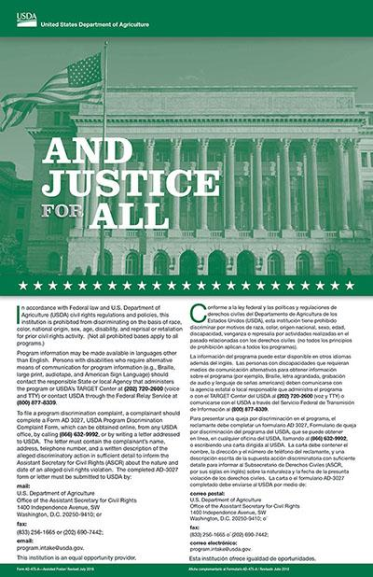
“And Justice For All” Poster
United States Department of Agriculture
Display the poster in a prominent location for all to view
AD-475A
New required version for CSFP and TEFAP
Notes:
The poster must be displayed in an area visible to program applicants and participants. Complaint forms must be posted near the poster and available for participants to take without asking. If applicable, TEFAP Written Notice of Beneficiary Rights must be posted as well.

Slide 19
LEP Requirements
United States Department of Agriculture
Title VI and its implementing regulations, Executive Order 13166, and USDA LEP guidance require Federal agencies and recipients (State agencies, local agencies, or other subrecipients), to take
reasonable steps to ensure “meaningful” access to their programs and activities by Limited English Proficient (LEP) persons.
(FNS Instruction 113-1, Section VII)
Notes:
LEP = Limited English Proficiency
Agencies take reasonable steps to ensure “meaningful” access to their programs and activities by Limited English Proficient (LEP) persons.

Slide 20
LEP Requirements
United States Department of Agriculture
Who are persons with LEP?
Individuals who do not speak English as their primary language and who have a limited ability to read, speak, write, or understand English because of their national origin

Slide 21
What is Meaningful Access?
United States Department of Agriculture
Meaningful access is accomplished by providing competent, accurate, timely and effective language services at no charge to individuals with LEP when accessing recipient programs and activities.
Failure to provide “meaningful” access to persons with LEP could be discrimination on the basis of national origin.
Notes:
An LEP plan for meaningful access is a strategy for organizations to identify LEP persons who need language assistance, ways the assistance will be provided, train staff, provide notice and monitor and update their plans.

Slide 22
LEP and Program Access
United States Department of Agriculture
Factors to consider in when ensuring “meaningful” access:
Number or proportion of LEP persons eligible to be served or likely to be encountered within the area serviced by the recipient
Frequency with which LEP individuals come in contact with the program
Nature and importance of the program, activity, or service
provided by the program
Resources available and their costs
Notes:
Large number – provide materials in native language, translators, etc.

Slide 23
LEP and Program Access
United States Department of Agriculture
State agencies must conduct assessments to determine language profile for their State, taking into account regional differences and updating as appropriate.
Translation of vital documents is required.
Oral translations and notification of free interpretation services
is required.
Staff training regarding how to provide LEP populations with meaningful access is paramount (frontline staff).
Notes:
The US Department of Justice has a website at www.lep.gov that contains a wealth of useful information for ensuring access to benefits for LEP applicants and participants. This includes downloadable I Speak cards, which allow the LEP individual to point to the language he/she speaks to facilitate finding an appropriate interpreter.

Slide 24
LEP and Program Access
United States Department of Agriculture
Language services:
Applicants and participants cannot be asked to bring
their own interpreters
Children should not be used as interpreters
Use qualified, competent language resources
Examples of language services:
Qualified, competent bilingual staff
Telephone interpreter lines
Oral interpretation services
Written language services
Qualified, competent community organizations and volunteers
Notes:
Read slide

Slide 25
LEP Population and Data Sources
United States Department of Agriculture
Population data sources:
▪
Department of Justice site: LEP.GOV
http://www.lep.gov/maps/
US Census Data http://www.census.gov/2010census/data/
American Community Survey http://www.census.gov/acs/
Migration Policy Institute’s National Center on Immigrant Integration Policy http://www.migrationpolicy.org/
Notes:
Here are some government websites you can access to gain more information on the language groups that may be encountered in your service area.

Slide 26
Disability Discrimination
United States Department of Agriculture
What is the definition of disability?
A person who has a physical or mental impairment which substantially limits one or more major life activities, has a record of such an impairment, or is regarded as having such an impairment.
Major life activity means functions such as caring for one’s self, performing manual tasks, walking, seeing, hearing, speaking, breathing, learning and working.
Functions of the immune system, normal cell growth, digestive, bowel, bladder, neurological, brain, respiratory, circulatory, cardiovascular, endocrine, and reproductive functions.
(ADA Amendments Act of 2008)
Notes:
It is important to remember that in the context of the Americans with Disabilities Act, “disability” is a legal term rather than a medical one. Because it has a legal definition, the ADA’s definition of disability is different from how disability is defined under some other laws. A person with a disability has a physical or mental impairment which substantially limits one or more life activities, has a record of such an impairment, or is regarded as having such an impairment.

Slide 27
Disability Discrimination
United States Department of Agriculture
Section 504 states that “no otherwise qualified individual with a disability in the United States… shall solely by reason of his or her disability, be excluded from, denied the benefits of, or be subjected to discrimination under” any program or activity that either receives Federal financial assistance or is conducted by any Executive agency or the United States Postal Service.”
The ADA has similar nondiscrimination requirements that prohibit discrimination on the basis of disability in services, programs, and activities provided by State and local government entities.

Slide 28
Disability Discrimination
United States Department of Agriculture
There is an obligation to ensure that members of the public are provided reasonable modifications in order to access program information, applications and assistance (i.e. Braille, large print, and audio tape).
Providing qualified sign language interpreters or other auxiliary aids and services for persons with hearing disabilities may be necessary to effectively communicate with these applicants and participants.
Notes:
Highlight that reasonable modifications should be made to assist those with disabilities

Slide 29
Disability Discrimination
United States Department of Agriculture
As programs and offices modernize, it is imperative that websites, including State and local agency websites, and online application systems are readily accessible to and useable by persons with visual impairments and other disabilities.
In addition, programs must ensure physical accessibility for buildings and facilities, particularly to persons in wheelchairs and with mobility disabilities.
Programs must permit service animals to accompany people with disabilities in all areas where the public is allowed to go.
Notes:
Programs must ensure physical accessibility for buildings and facilities, particularly to persons in wheelchairs and with mobility disabilities. Agencies naturally assist with carrying of groceries, and helping clients. Programs must permit service animals.

Slide 30
Equal Opportunity for Religious
Organizations
United States Department of Agriculture
7 CFR Part 16
Ensures a level playing field for the participation of faith-based organizations and other community organizations in USDA programs.
Notes:
7 CFR Part 16 ensures a level playing field for the participation of Faith-Based Organizations and Charitable-Based Organizations in FNS programs.
Faith Based Organizations CAN:
Receive federal funds to operate emergency feeding programs.
Use space in their facilities without removing religious art or symbols.
Faith Based Organizations CANNOT:
Discriminate against individuals on the basis of religion or religious beliefs.
Use USDA funds or products for religious activities.
Distribute religious information to clients.
Make clients participate in a religious activity in order to receive assistance
These provisions were meant to ensure that federal funding is used strictly for the goals of the program – the delivery of nutrition assistance as provided for in public law.
As it applies to FNS Food Distribution programs, USDA funds cannot be used to proselytize. In other words, churches and faith-based organizations cannot include religious materials in USDA food boxes, nor can they make a meeting with a pastor a condition of receiving USDA commodities.
TEFAP Written Notice of Beneficiary Rights must be posted.
Separate time and space!!
This last point doesn’t mean that you cannot schedule a religious activity such as a prayer service around a distribution. It means that you have to allow sufficient time for your distribution so that those who do not want to participate in the religious activity can still receive their food. For example, you can schedule your distribution to occur between the hours of 10 am and noon with the prayer service happening between 10 and 10:30. As long as you let your clients know about the scheduled prayer service and the time of distribution outside the prayer service, you will be in compliance.

Slide 31
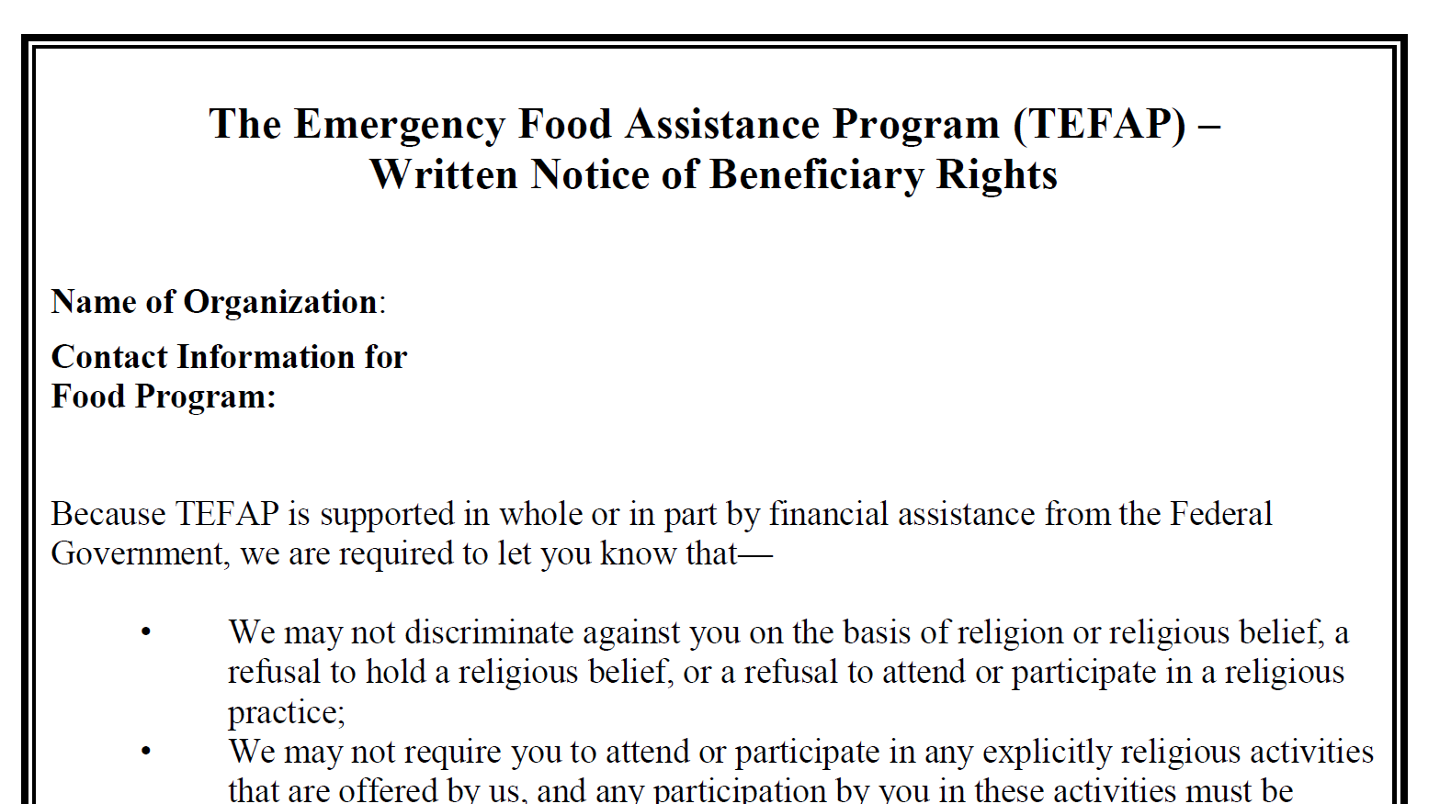
TEFAP Written Notice of Beneficiary Rights
Notes:
If your agency is faith based, must post this notice in clear view, during distribution.

Slide 32
Complaints of Discrimination
United States Department of Agriculture
Complaints must be filed within 180 days from the alleged act of discrimination, with exceptions.
Complaints may be written, verbal, or anonymous.
State agencies or subrecipient agencies may develop their own complaint forms, but the use of such forms cannot be a pre- requisite for acceptance.
A separate Civil Rights complaint log shall maintained by the State & subrecipient agency;
Confidentiality is extremely important and must be maintained.
Notes:
Complaints must be filed within 180 days from the alleged act of discrimination, with exceptions.
If there is ever conflict or a tough situation, have all involved document their account of the incident. Document dates… Call your lead agency to discuss any issues so that they also document. Go with your gut….

Slide 33
Complaints of Discrimination
United States Department of Agriculture
Complaints based on all protected bases
Must be forwarded to FNS Civil Rights Division within 5 calendar days.
USDA discrimination complaint form
English
http://www.ocio.usda.gov/sites/default/files/docs/2012/Co mplain_combined_6_8_12.pdf
Spanish
http://www.ocio.usda.gov/sites/default/files/docs/2012/Spa nish_Form_508_Compliant_6_8_12_0.pdf
Notes:
Forms must go directly to the address for USDA.

Slide 34
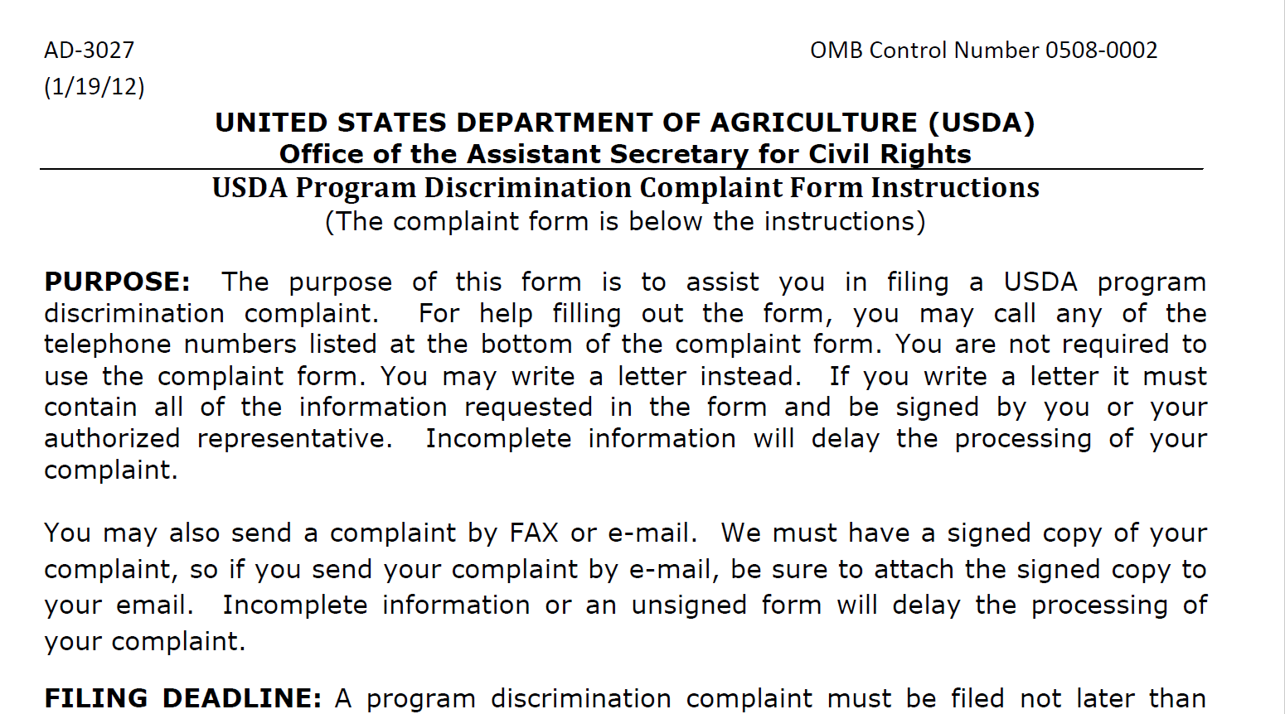
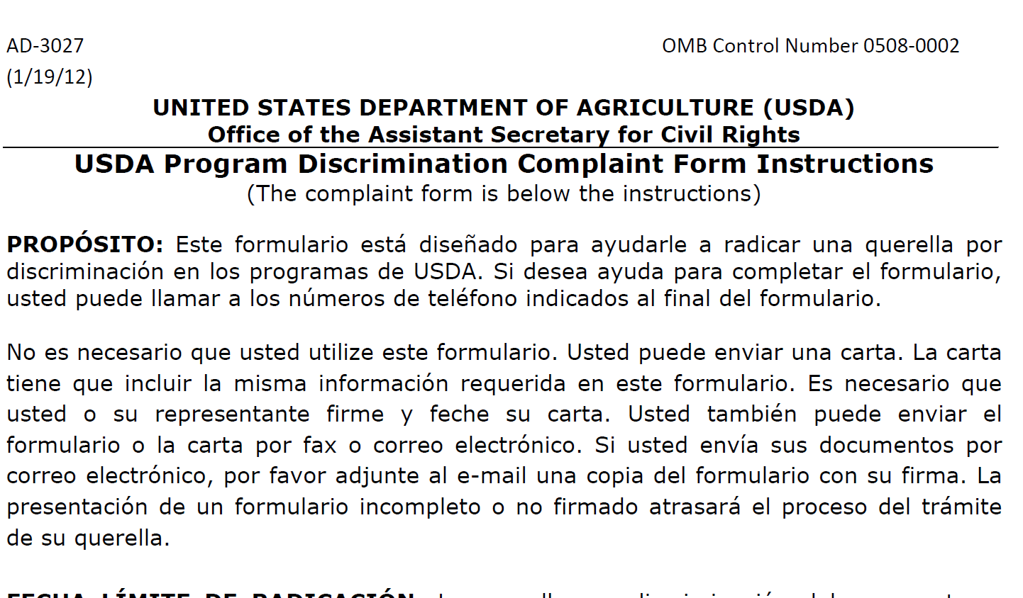
USDA Complaint Forms
Notes:
Must be posted and made readily available. Client should not have to ask for.

Slide 35
Compliance Reviews
United States Department of Agriculture
Examine the activities of State agencies, subrecipients, and local sites to determine Civil Rights compliance.
FNS Civil Rights and Program staff review State agencies.
State agencies review their subrecipients.
Subrecipients review their local agencies.
Significant findings must be provided in writing to the reviewed entity and to FNS.
Notes:
Process of compliance reviews – top down
Review process

Slide 36
Compliance Reviews
United States Department of Agriculture
There are three types of compliance reviews:
Pre-Award Compliance Reviews
Routine (Post-Award) Compliance Reviews
Special Compliance Reviews

Slide 37
Pre-Award Compliance Reviews
United States Department of Agriculture
State agencies, subrecipient agencies, and local sites must be in compliance with Civil Rights requirements prior to approval for Federal financial assistance.
Notes:
Pre-Award Questionnaire – new agencies only!

Slide 38
Routine/Post-Award Reviews
United States Department of Agriculture
FNS and State agencies must conduct routine compliance reviews as identified by FNS Instruction 113-1 and program-specific regulations and policies.
Assess all of the Civil Rights compliance areas.
Sample post-award review questions:
Do printed materials contain the nondiscrimination statement?
Is the “And Justice For All” poster displayed appropriately?
Are program informational materials available to all?
How are applicants and participants advised of their right to
file a Civil Rights complaint of discrimination?
Are reasonable modifications appropriately made for people with disabilities?
Notes:
PA Dept of Ag: Field representative site visit review (Joann Hock in Dauphin, Lancaster; Melissa Harris in Lycoming, Clinton).
These are normal reviews agencies are used to. Questions listed here are ones Joann or Melissa ask.

Slide 39
Special Compliance Reviews
United States Department of Agriculture
May be scheduled or unscheduled
To follow-up on previous findings of noncompliance
To investigate reports of noncompliance by other agencies, media, or grassroots organizations
May be specific to an incident or policy
History of statistical underrepresentation of particular group(s)
Pattern of complaints of discrimination
Notes:
Scheduled or unscheduled, usually involve incident or complaint.

Slide 40
Resolution of Noncompliance
United States Department of Agriculture
A factual finding that any civil rights requirement, as provided by law, regulation, policy, instruction, or guidelines, is not being adhered to by a State agency, subrecipient agency, or a local site.
Steps must be taken immediately to obtain voluntary
compliance.
A finding’s effective date is the date of notice to the reviewed entity.
Notes:
Non compliance- steps taken immediately to obtain VOLUNTARY compliance.

Slide 41
Customer Service
United States Department of Agriculture
Making a difference
Treat all people with dignity and respect
Answer questions in a voice that is non-threatening
Clearly explain to everyone the rules as well as their rights and responsibilities
Recognize when stress creates a problem in giving excellent service
Recognize that participants have varied needs and (sometimes) few resources
Notice when a person feels that they have been treated in a rude manner
Develop good listening skills
Notes:
This is the heart of civil rights training-read these.

Slide 42
Conflict Resolution
United States Department of Agriculture
How is your attitude?
Always clearly introduce yourself when answering the telephone and do not interrupt the caller.
Be patient. Give the client every opportunity to explain the issue.
Be understanding. Of all the communications situations that you encounter, angry clients require the most empathy.
Do not be judgmental.
Talk calmly and slowly; in a well-modulated voice (low pitch). This should help relax the person and allow you to address the facts, not cater to emotions.
Be sincere. Even if you sense that the problem is not the fault of your organization and clearly not your fault, it is ok to apologize to the client for his or her inconvenience; not necessarily the actions by your agency.
Be aware. Get help if threatened or if violence is possible.
Notes:
Important –read these!

Slide 43
Conflict Resolution
United States Department of Agriculture
What Steps do you need to take?
Remain calm
What is the problem? Using information provided, determine what the issue is
Determine a solution. Know your organization’s policy on handling situations and information needed to offer a solution
Gain approval from the client. Check with the client for their approval on a solution
Make an agreement. You and the client should determine what is to be done, when it is to be done, and by whom and alternatives if needed.
Follow up. Personally make sure that the client has been satisfied, and provide feedback.
Notes:
Read these.

Slide 44
Customer Service
United States Department of Agriculture
Service is
Effectively communicating with customers,
Responding to their needs,
Valuing their worth, and
Instilling excellence through
Courtesy, confidence, and
Enthusiasm.
Notes:
Here are some tips for great customer service:
Treat everyone with dignity and respect; welcome them with a smile
Answer any and all questions in a non-threatening voice and manner
Explain all of your policies and make sure applicants and participants understand their rights and responsibilities
Recognize when stress creates a problem and find ways to cope with the situation in a calm manner
Don’t feel you need to have the last word
Recognize that everyone is different and your clients will have varied needs and limited resources
Notice when a person feels that they have been treated rudely and acknowledge that feeling; take steps to improve the situation. Be polite and empathetic and avoid sarcasm.

Slide 45
Conflict Resolution
United States Department of Agriculture
IDENTIFY THE PROBLEM. Identify the problem based on the information the customer gives you.
DETERMINE A SOLUTION. Depending on the specifics of the conversation and your knowledge of your organization, the solution may involve calling the customer again.
GAIN APPROVAL FROM THE CUSTOMER. If the customer does not agree to the proposed solution, it will resolve nothing!
MAKE AN AGREEMENT. You and the customer should determine what is to be done, when it is to be done, and by whom. If it is not possible, suggest an alternative.
FOLLOW UP. Personally make sure that the customer has been satisfied; and provide feedback.
Notes:
Have a written and posted policy for dealing with unacceptable behavior and conflicts. Here are some suggestions:
When answering the telephone, always clearly introduce yourself and never interrupt the caller.
Be patient; give the client the opportunity to explain what happened
Be understanding; an angry client requires the most empathy
Don’t be judgmental
Respond in a calm manner. Staying calm should help the client to relax, which in turn allows you to consider and address the facts, not the emotions.
Be sincere. It’s always okay to apologize to the client for his inconvenience even if you feel that the problem is not your organization’s fault.
Be aware. If you feel you are being threatened or if violence is possible, get help immediately.

Slide 46
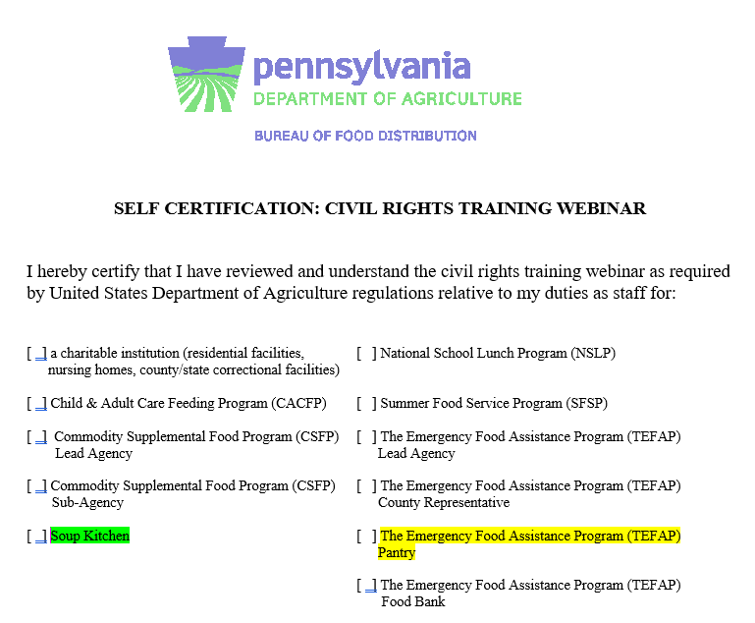
Self Certification Form
Notes:
Check the box for Soup kitchen or TEFAP Pantry.
Put today’s date on it.
You sign front as lead, write in your agency
Have front line staff sign on back when they’ve done training.
Keep the form on your premises.

Slide 47
Questions
United States Department of Agriculture

Slide 48
Contact Information
Michele Sazo
USDA, Food and Nutrition Service
Mid-Atlantic Regional Civil Rights Director
Telephone: (609) 259-5061
Email: michele.sazo@fns.usda.gov

